Slide 1
BR US discount sensitivity model
MARCH 2017
PLATFORM ANALYTICS

Slide 2

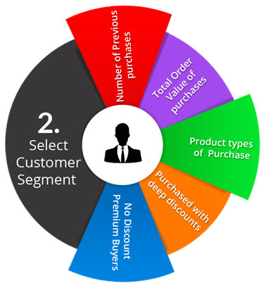
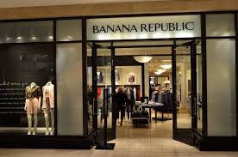

BACKGROUND
Objective:
Every year company shells out billions of $ in various discount offered
Not all Customers have affinity for discounts, to make a purchase
This creates an opportunity to save on revenue by offering relevant discounts only to “Discount Sensitive” customers
The whole exercise will help in:
Increasing Revenue
Saving Cost
Improving Customer Experience
Definitions:
Response: customers taking above 35% of gross sales as discounts in an year
Response score: Probability of a customer to search discount above 35% to make purchase
Behavior
Observation/Response
Training
Transactions & Browse Data
Jan2015-Dec2015
Purchase Data
Jan2016-Dec2016
Validation
Transactions & Browse Data
Jul’14-Jun’15/Feb’14-Jan’15
Purchase Data
Jul’15-Jun’16/Feb’15-Jan’16
Algorithms | Library
Ensemble Leaners | xgboost, ada, adabag, gbm, randomForest
Support Vector Machines | kernlab
Logistic Regression
Deep Learning | mxnet, h2o, tensorflow, darch, scikit-learn
Data preparation
Exploratory Analysis
Scaling and Outlier Treatment
Dataset Size involved : 4.7M (Customer Keys), Response – 20.2%
Model Execution and Testing
Model Evaluation and Validation
Model Training

Slide 3
PREDICTORS AND RELATIVE IMPORTANCE
Please click on the attachment below to see all the predictors considered and their impact on response

Slide 4
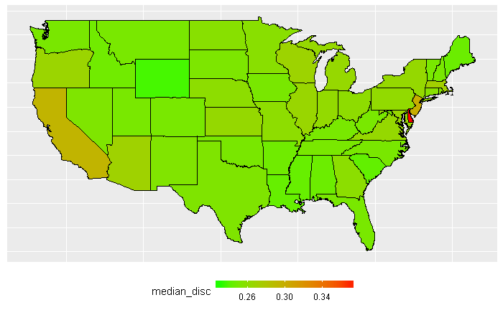
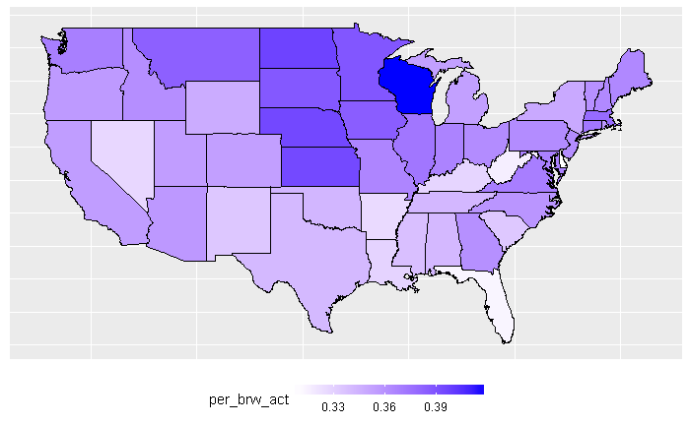
INTERESTING FACTS ABOUT DISCOUNT TAKEN
Discount sensitive customers are also most likely online active customers as per our database
Geography wise they follow the same pattern

Slide 5
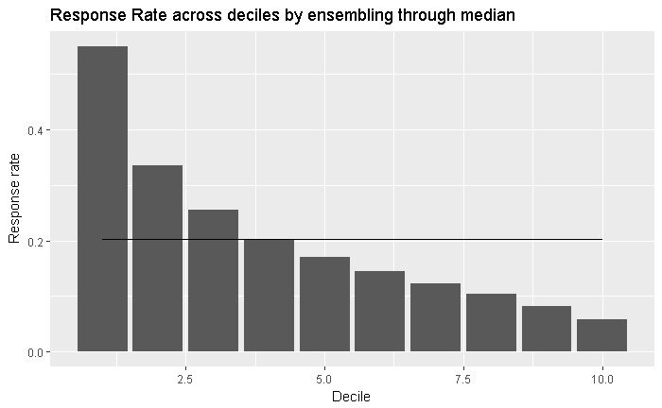
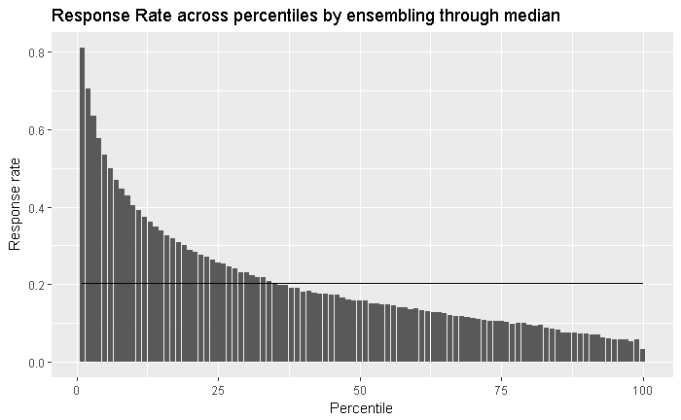
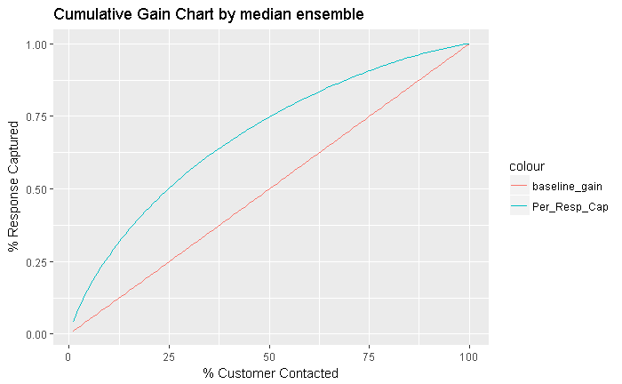
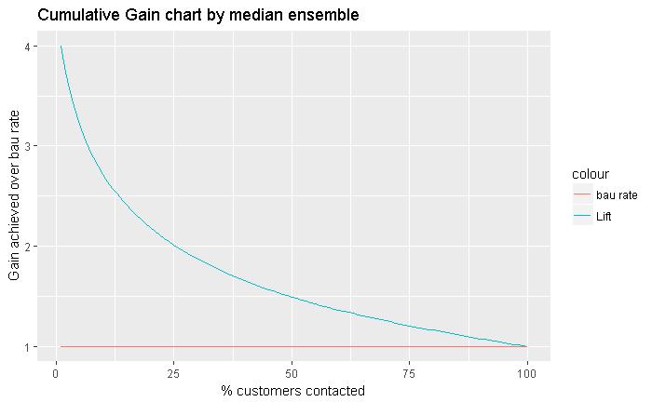
MODEL RESULTS – VALIDATIONS JUL15-JUN16
Decile | Customers | Number of Responder | Cum Responders | Response Rate | Response Gain | Cumulative Response Rate | Lift
1 | 472,243 | 260,026 | 260,026 | 55.1% | 27.2% | 55.1% | 2.72
2 | 472,244 | 158,415 | 418,441 | 33.5% | 43.7% | 44.3% | 2.19
3 | 472,243 | 120,468 | 538,909 | 25.5% | 56.3% | 38.0% | 1.88
4 | 472,244 | 95,893 | 634,802 | 20.3% | 66.3% | 33.6% | 1.66
5 | 472,244 | 80,267 | 715,069 | 17.0% | 74.7% | 30.3% | 1.49
6 | 472,243 | 68,752 | 783,821 | 14.6% | 81.9% | 27.7% | 1.37
7 | 472,244 | 58,311 | 842,132 | 12.3% | 88.0% | 25.5% | 1.26
8 | 472,243 | 48,850 | 890,982 | 10.3% | 93.1% | 23.6% | 1.16
9 | 472,244 | 38,555 | 929,537 | 8.2% | 97.1% | 21.9% | 1.08
10 | 472,244 | 27,395 | 956,932 | 5.8% | 100.0% | 20.3% | 1.00
Model Summary:
Among many models , GBM algorithm was picked based on model performance.
Out of 2000 GBM models, best 20 have been picked and data is scored . Ensemble of median score was taken as final probability which was used for validation

Slide 6
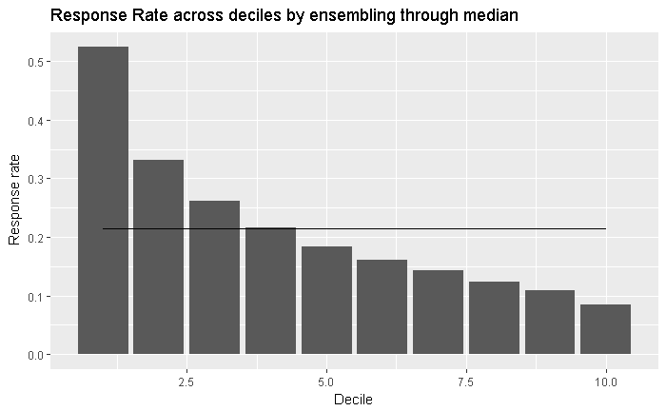
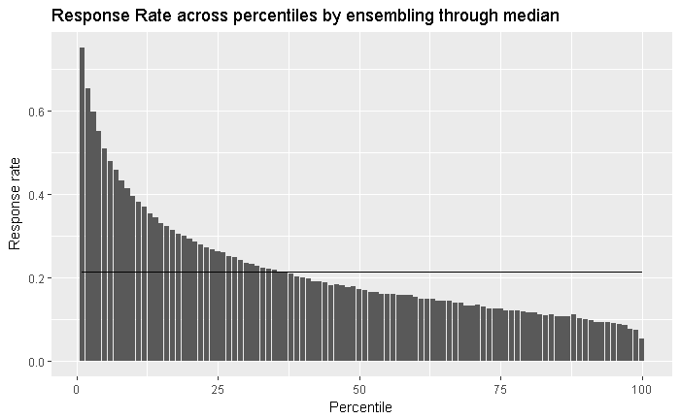
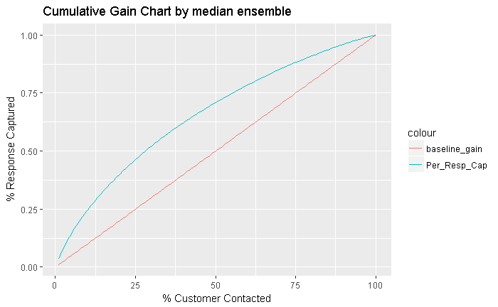
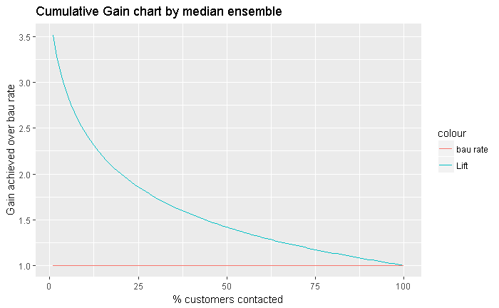
MODEL RESULTS – VALIDATIONS FEB15-JAN16
Decile | Customers | Number of Responder | Cum Responders | Response Rate | Response Gain | Cumulative Response Rate | Lift
1 | 410,545 | 215,593 | 215,593 | 52.51% | 24.53% | 52.51% | 2.45
2 | 410,545 | 136,164 | 351,757 | 33.17% | 40.03% | 42.84% | 2.00
3 | 410,545 | 107,103 | 458,860 | 26.09% | 52.21% | 37.26% | 1.74
4 | 410,545 | 88,788 | 547,648 | 21.63% | 62.32% | 33.35% | 1.56
5 | 410,545 | 75,739 | 623,387 | 18.45% | 70.93% | 30.37% | 1.42
6 | 410,545 | 66,164 | 689,551 | 16.12% | 78.46% | 27.99% | 1.31
7 | 410,545 | 58,678 | 748,229 | 14.29% | 85.14% | 26.04% | 1.22
8 | 410,545 | 51,056 | 799,285 | 12.44% | 90.95% | 24.34% | 1.14
9 | 410,545 | 44,795 | 844,080 | 10.91% | 96.05% | 22.84% | 1.07
10 | 410,545 | 34,751 | 878,831 | 8.46% | 100.00% | 21.41% | 1.00
Model Summary:
Among many models , GBM algorithm was picked based on model performance.
Out of 2000 GBM models, best 20 have been picked and data is scored . Ensemble of median score was taken as final probability which was used for validation

Slide 7
APPENDIX

